Slide 1

DATABASE DESIGN PROJECT
Group 8

Slide 2
INTRODUCTION
  Campus canteens often face long queues, especially during peak hours, causing students to lose valuable time.
  Traditional ordering methods are manual and inefficient, leading to delays and mismanagement.
  There is a growing need for a digital solution that allows students to pre-order food and helps canteen staff manage orders efficiently.
  Our project,Foodzy, aims to streamline the ordering process, reduce waiting time, and enhance the overall campus dining experience.

Slide 3
PROBLEM STATEMENT – CURRENT SCENARIO
Campus canteens face significant challenges in handling large crowds during peak hours. Students often have to wait in long queues, sometimes up to 30 minutes or more, which results in wasted time and frustration. Manual order-taking systems are inefficient, prone to errors, and unable to manage high-volume demand effectively. Menu changes, stock availability, and special orders are often mismanaged, creating confusion for both students and staff. Additionally, there is no real-time monitoring of orders or queue management, making it difficult to streamline operations or provide timely service. These issues collectively result in a poor dining experience and highlight the urgent need for a technological solution that can address both student convenience and canteen efficiency.

Slide 4
PROBLEM STATEMENT – IMPLICATIONS
The inefficiency in campus canteens not only impacts students but also has broader operational consequences. Prolonged waiting times frustrate students and may lead to skipped meals or overcrowding in other areas. Canteen staff face increased pressure and stress while trying to manage orders manually, which can result in errors, mismanagement, and slower service. The lack of data and analytics prevents staff from understanding peak demand periods or popular menu items, making resource planning difficult. Over time, these inefficiencies can affect overall student satisfaction, reduce the canteen’s operational productivity, and create a negative perception of campus facilities. Therefore, addressing these issues is essential to ensure a smooth, organized, and student-friendly dining experience.

Slide 5
OBJECTIVE
  Reduce waiting time and improve student convenience.
  Enable digital pre-ordering and payment.
  Help staff track and manage orders efficiently.
  Optimize workflow and minimize errors.
  Collect data for informed decision-making.

Slide 6
SOLUTION OVERVIEW
Foodzy is a smart and interactive platform that bridges the gap between students and canteen staff. Students can place orders from their devices without standing in queues, while staff can receive and process orders in an organized manner. The system integrates notifications, order tracking, and digital payments to ensure a smooth experience. By leveraging technology, Foodzy transforms the traditional canteen into a data-driven, efficient, and modern service, improving satisfaction for both students and staff.The solution is scalable and can be adapted for multiple canteens across the campus.

Slide 7
FEATURES – STUDENT SIDE
  Browse digital menu and check availability.
  Pre-order food in advance to save time.
  Notifications when order is ready.
  Secure digital payment options.
  Easy-to-use interface for all students.

Slide 8
FEATURES – CANTEEN SIDE
  Real-time order monitoring.
  Queue management for efficient service.
  Track stock and inventory levels.
  Analytics for peak hours and popular items.
  Reduce errors and mismanagement.

Slide 9
SYSTEM ARCHITECTURE
Foodzy’s architecture integrates a frontend, backend, database, and notification system. Students place orders through the app or website, which are processed by the backend server and stored in the database. Staff can view, manage, and update order status in real-time. Notifications are sent to students when orders are ready, ensuring seamless communication. The architecture is scalable, secure, and designed for efficient data flow, providing a smooth experience for both students and staff.

Slide 10
WORKFLOW
  Student logs in and views menu.
  Places order with selected items.
  Order sent to canteen system in real-time.
  Staff prepares order according to priority.
  Notification sent to student when order is ready.
  Student collects order without waiting in queue.

Slide 11
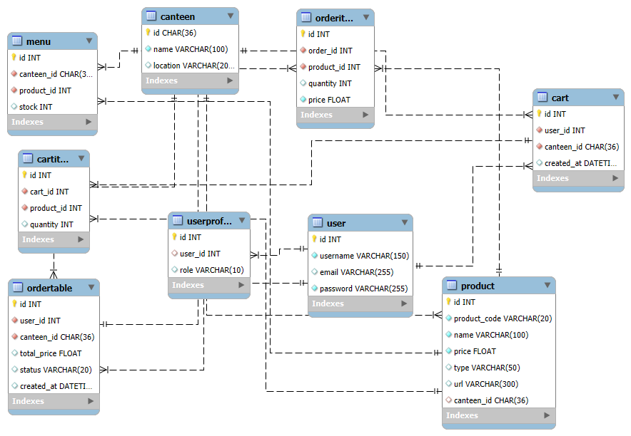
ER DIAGRAM

Slide 12
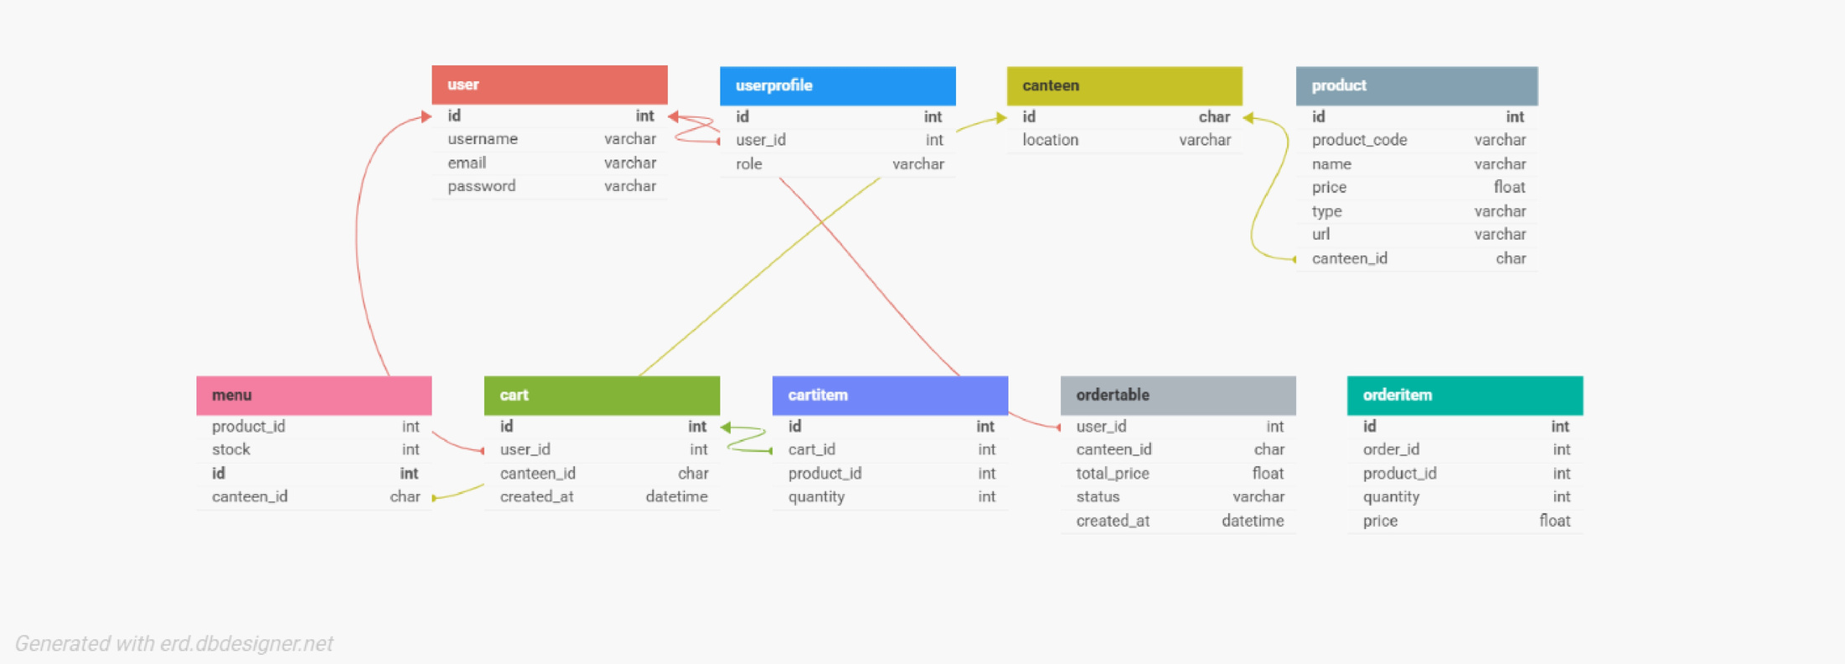
SCHEMA DIAGRAM

Slide 13
TECH STACK
  Frontend: React / HTML / CSS.
  Backend: Python / Node.js.
  Database: MySQL / PostgreSQL.
  Secure, scalable, and reliable design.

Slide 14
BENEFITS – STUDENTS
  Save time and avoid queues.
  Convenient pre-ordering and payment.
  Accurate and timely order delivery.
  Better meal planning during peak hours.
  Enhanced dining experience.

Slide 15
BENEFITS – CANTEEN STAFF
  Organized workflow and reduced errors.
  Real-time queue management.
  Analytics for inventory and peak-hour planning.
  Improved operational efficiency.
  Better coordination among staff.

Slide 16
DATA ANALYTICS
Foodzy collects valuable data on orders, peak hours, and popular menu items, providing actionable insights. These analytics help canteen staff optimize preparation schedules, manage inventory efficiently, and plan staffing for busy hours. The insights can also be used to improve menu offerings based on student preferences, enhancing satisfaction and reducing waste.

Slide 17
CHALLENGES
Despite its advantages, Foodzy faces some challenges. The system relies on internet connectivity, and some students or staff may require time to adapt to the platform. Initial setup involves hardware configuration and staff training. Offline functionality is limited, which may affect usability during network issues. Addressing these challenges is essential for smooth implementation and adoption.

Slide 18
FUTURE SCOPE
  AI-based demand prediction for menu planning.
  Campus ID integration for payment.
  Loyalty and reward programs.
  Expansion to multiple campus canteens.
  Data-driven decision-making for management.

Slide 19
COST & FEASIBILITY
  Low to medium development cost.
  Minimal hardware requirement.
  Simple maintenance with periodic updates.
  Scalable for multiple canteens.
  High return in efficiency and satisfaction.

Slide 20
CONCLUSION
Foodzy provides a comprehensive digital solution to long queues in campus canteens. It improves convenience for students, enhances operational efficiency for staff, and enables data-driven decisions. By combining technology, analytics, and user-friendly design, Foodzy ensures a smooth, organized, and modern dining experience, with potential for future growth and expansion across multiple campus locations.

Slide 21
THANK YOU
Group Members:
Aswath S - [CB.PS.I5DAS23117]
Hari Krishna - [CB.PS.I5DAS23127]
Nagaraj Thamizharasan - [CB.PS.I5DAS23128]
Sandeep Patel - [CB.PS.I5DAS23144]
Sriram D - [CB.PS.I5DAS23156]

